Slide 1

比特币 实现技术解析
持有、支付、挖掘比特币原理及协议
Andy Wu (吴增德）
2017－05－29
Notes:
Own, Send, Mine bitcoins
Public –Private Key Encryption
Question:
How the bitcoin is transferred, How the bitcoin is flowed
Bitcoin core code analysis

Slide 2
How Bitcoin Works
Andy Wu (吴增德）
2017－05－29
Notes:
Own, Send, Mine bitcoins
Satoshi Nakamoto

Slide 3
What is Bitcoin
Ledger
____ ____
____ ____
____
Ledger
Ledger
____ ____
____ ____
____
Ledger
____ ____
____ ____
____
Alice | 5.4
Bob | 100
Frank | 700
Carlos | 0.0000001
… | 1
Ledger
____ ____
____ ____
____
Ledger
____ ____
____ ____
____
Ledger
____ ____
____ ____
____
Ledger
____ ____
____ ____
____
Ledger
____ ____
____ ____
____
Ledger
____ ____
____ ____
____
Ledger
____ ____
____ ____
____
Ledger
____ ____
____ ____
____
Ledger
____ ____
____ ____
____
Notes:
How transaction is done
How to transfer
RSA
Bitcoin cryptography
HASH 256
To understand: blockchain.info
Youtube: blockchain.info

Slide 4
Sending Money
Ledger
____ ____
____ ____
____
Ledger
____ ____
____ ____
____
Ledger
____ ____
____ ____
____
Ledger
____ ____
____ ____
____
Alice → Bob 5.0 BTC
Ledger
____ ____
____ ____
____
Ledger
____ ____
____ ____
____
Ledger
Alice 25
Bob 10
____ ____
Alice → Bob 5 BTC
June → Dave 8 BTC
Andy → Juan 6 BTC
Sam → John 4 BTC
20
15
Ledger
Alice 25
Bob 10
____ ____
20
15
Passing other’s transactions along
Ledger
Alice 25
Bob 10
____ ____
20
15
A→B
50 BTC
A→B
50 BTC
A→B
50 BTC

Slide 5
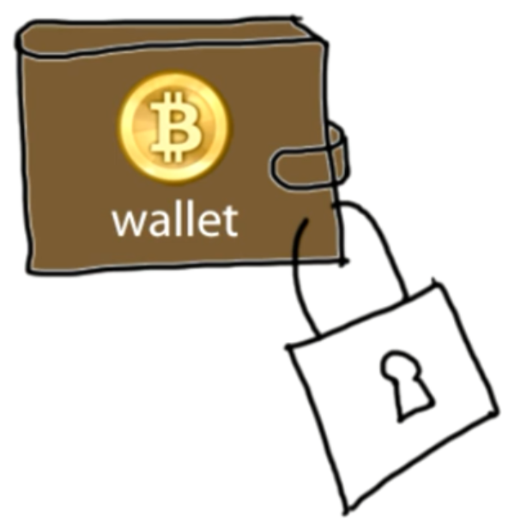
Sending Money & Authentication
Transaction Messages
Digital Signature
Alice → Bob 5 BTC d302721…
June → Dave 8 BTC 81758de…
Andy → Juan 6 BTC 17512c8…
Sam → John 4 BTC 9eac123…
? Alice ?
Digital Signature
Bf853d30272138df448817512c8de9cc3f75849eac1234cc …
different every time
Create
Verify
Signature = f(message, private key)
1=? V(message, public key, signature)

Slide 6
Digital Signature
Digital Signature Math
ecdsa (elliptic curve digital signature algorithm)
”mathematical trap door”
Transaction Message
Transaction Message
Transaction Message
Digital Signature
Transaction Message
Transaction Message
Transaction
493830493 493168268 …
Transaction
493830493 493178268 …
Transaction
493830493 493178268 …
Dig Signature
Dig Signature
Dig Signature

Slide 7
Transactions in more detail
Signature = f(message, private key)
1=? V(message, public key, signature)
Create
Verify
Input
A public key
that belongs to the redeemer of the output transaction.
2) An ECDSA hash
Output contains
Amount: being sent to the recipient.
Change
being sent back to the original sender (if any)
Voluntary transaction fee
Block chain
prevents the double spend attack
by giving other nodes the power to verify that transaction inputs were not already spent somewhere else.

Slide 8
Coins flow from Inputs to Outputs
Create
Verify
A coin owner transfers coins by digitally signing (via ECDSA) a hash digest of the previous transaction and the public key of the next owner. This signature is then appended to the end of the coin.

Slide 9
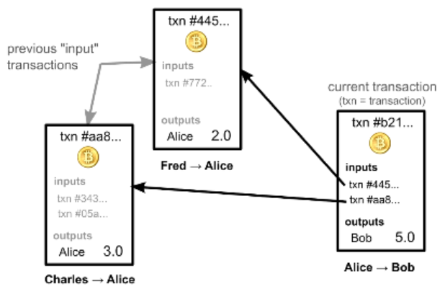
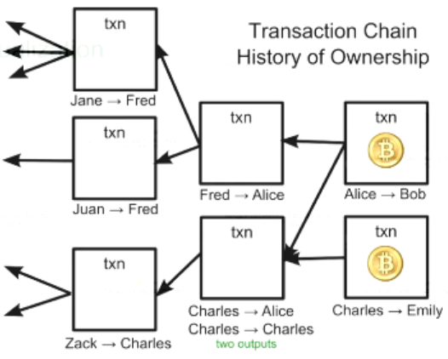
Account Balances
Ownership via previous transactions
Check previous transactions ~ 24h
Blockchain.info
Notes:
?? How the process pay 1.2, 2.5, 3.4

Slide 10
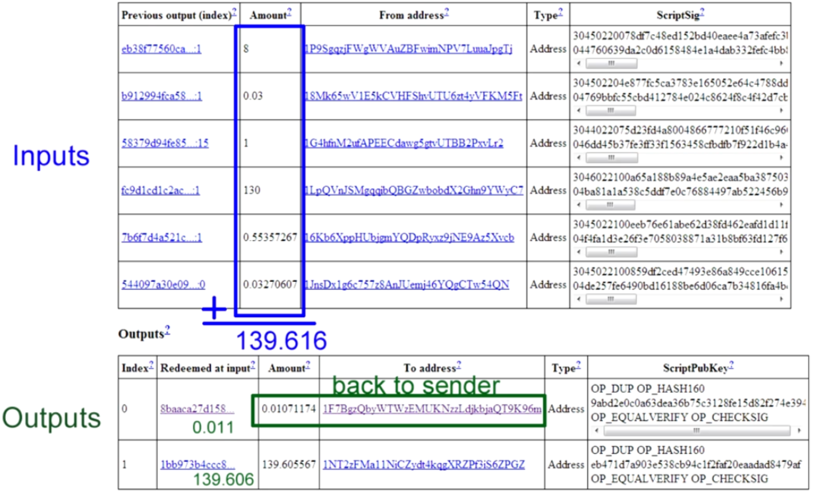
Real Transactions

Slide 11
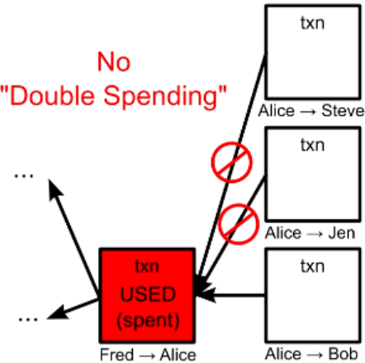
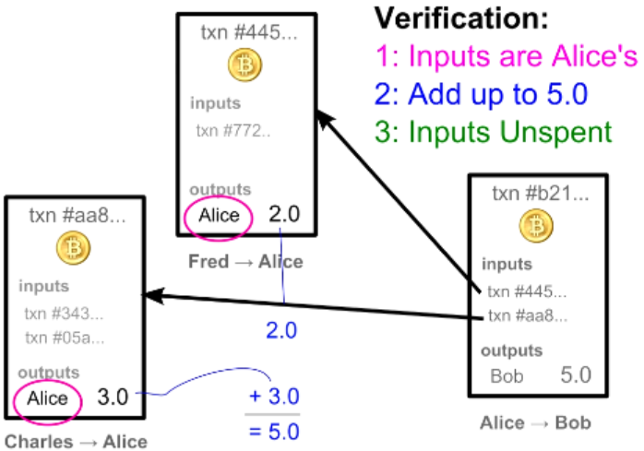
Transaction Verification
Each Transaction Can Only be Used Once as an input

Slide 12

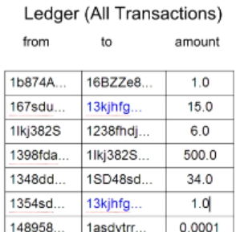
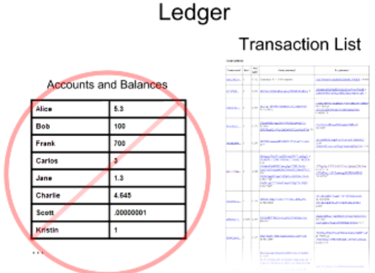
Balance Calculation
16

Slide 13
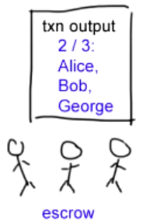
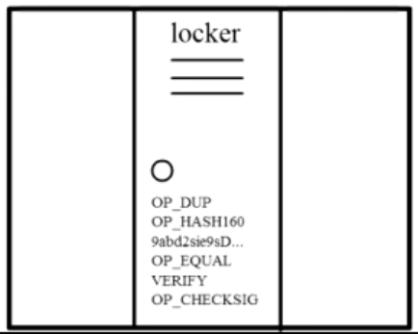
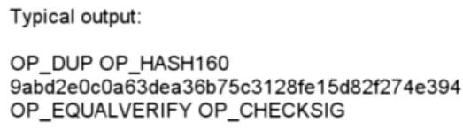
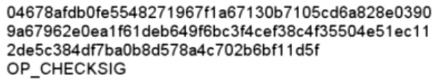
Complex Transactions: Mathematical Puzzles
Transactions: Mathematical Puzzles with locker
Defined with special Scripting language
Only owner can solve it
Support more complex conditions
First Transaction: 2009, Jan 3, 50BTC

Slide 14
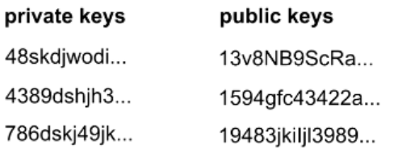
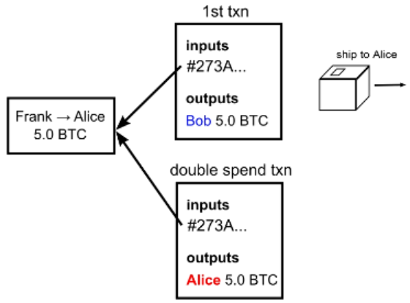
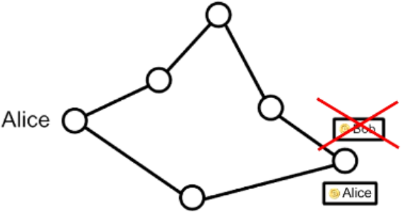
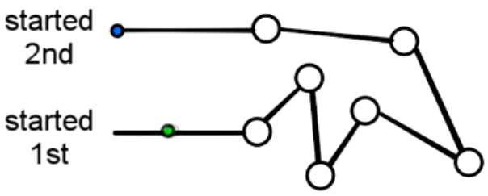
Transaction Security
Wallet
Anonymity
Possible bitcoin address: 2^160
Bitcoin transaction Security:
Digital Signatures
Referenced Transactions
Security Hole: Transaction Order
Double Spending Fraud
Nodes need to agree on transaction order

Slide 15
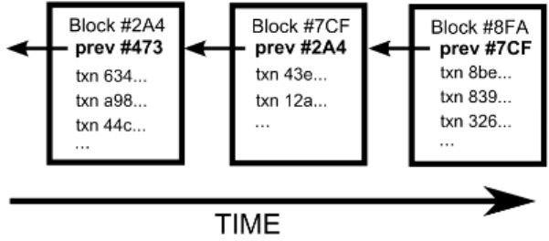
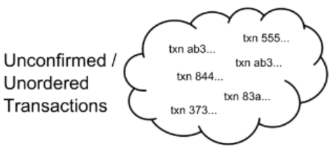
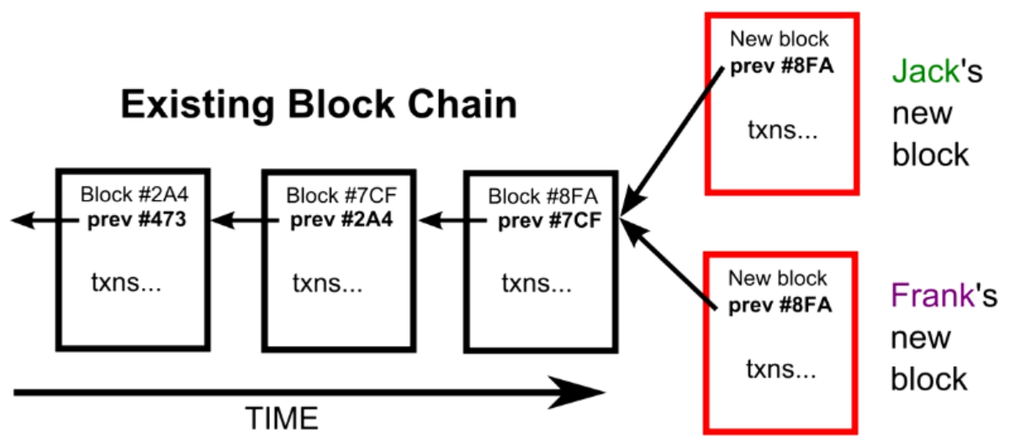
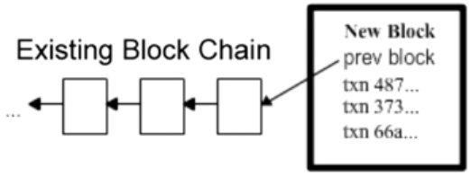
Block Chain
The Block Chain: Ordering Solution
Transaction Chain: History of Ownership
Unconfirmed Transactions
Add to new Block
Potential next blocks

Slide 16
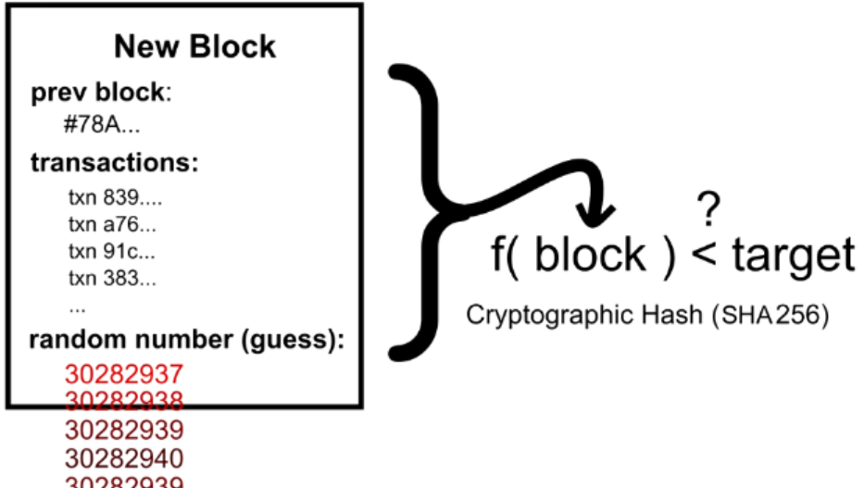
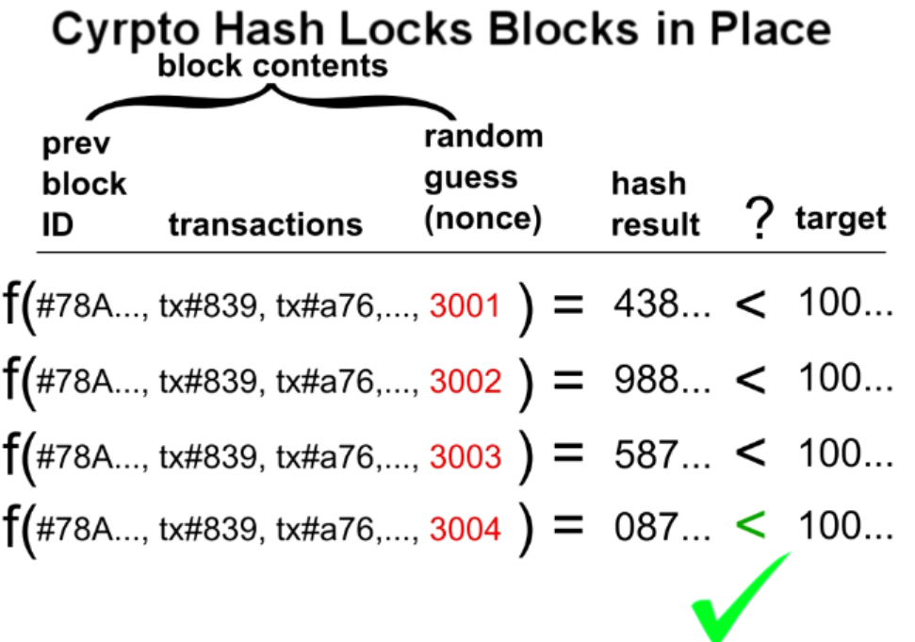
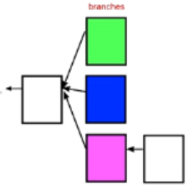
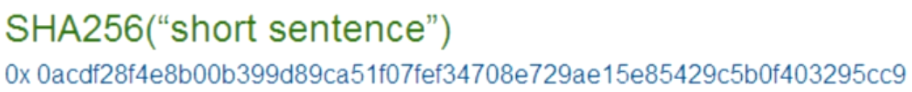
Cryptographic Hash
Block Puzzle
Block Puzzle: SHA256
Target: 000000000000A1B7E…

Slide 17
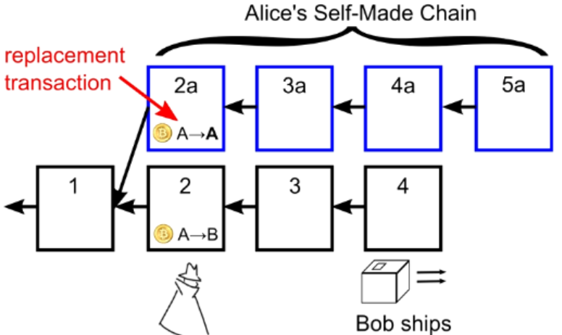
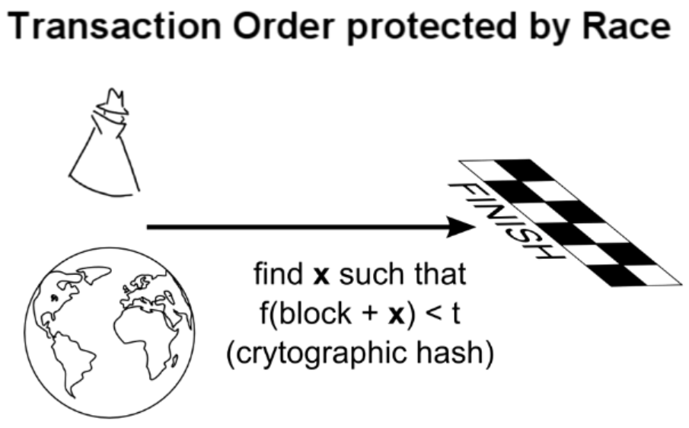
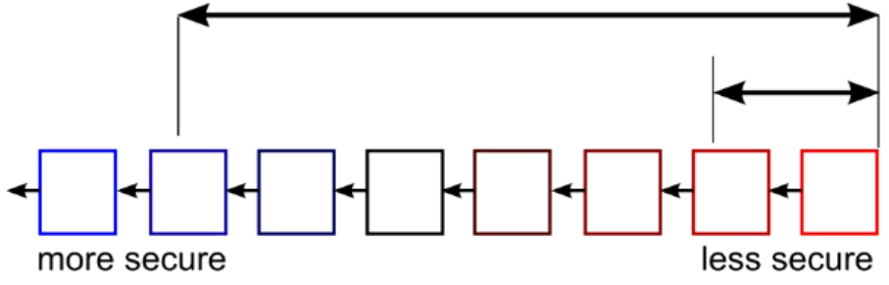
Double Spending Prevention
Only vulnerable at end of the chain: wait for several blocks before final
The attacker must out space or “out luck” the network”

Slide 18
Recap
Block Chain Orders Transactions
Next: BitCoin
Block Chain Orders Transactions

Slide 19
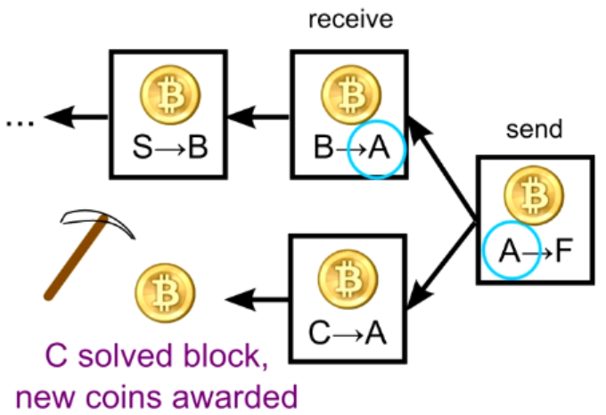
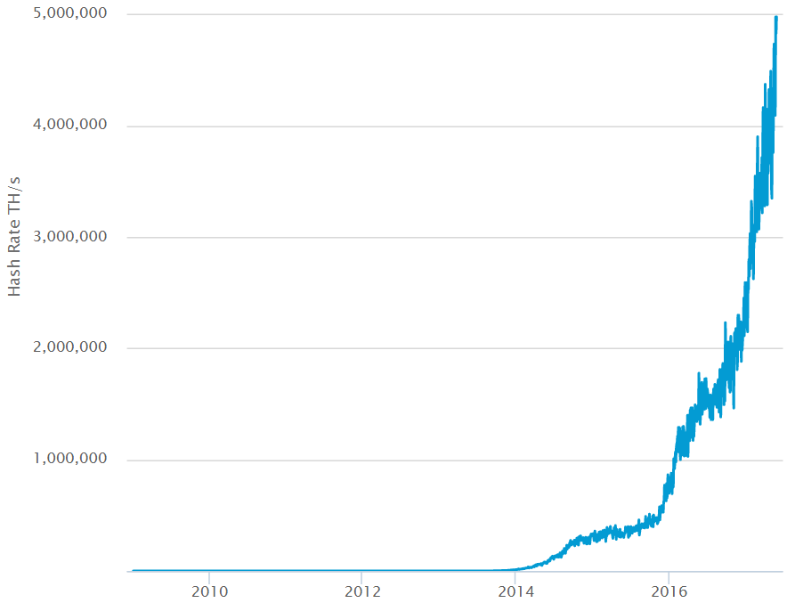
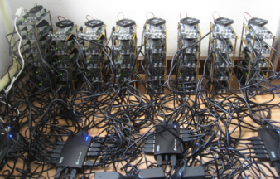
Mining
Real purpose:
Verify transactions
Safeguard the block chain
Mining:
Every 4 years, cut in half, every 10 minutes
all 21 million in 2140
Current 16.3 million
Smallest: 1/100,000,000 BitCoin = 1 Satoshi
Future: transactions
How 10 minutes:
Adjust difficulty every 2016 blocks, (around 2 weeks)
Links

Slide 20
Summery
Benefits
Government can’t print money or manipulate currency
Anonymity
Lower global transaction costs
Challenges
Difficult to exchange
Used for illegal activity (Government can’t track
Mining, or solving blocks use large amount of energy
Mathematically protected digital currency
Maintained by a network of peers
Digital Signature:
Safeguard money
Transaction chains
Store history of ownership
Block Chain
Hold transaction order

Slide 21
Q & A

Slide 22
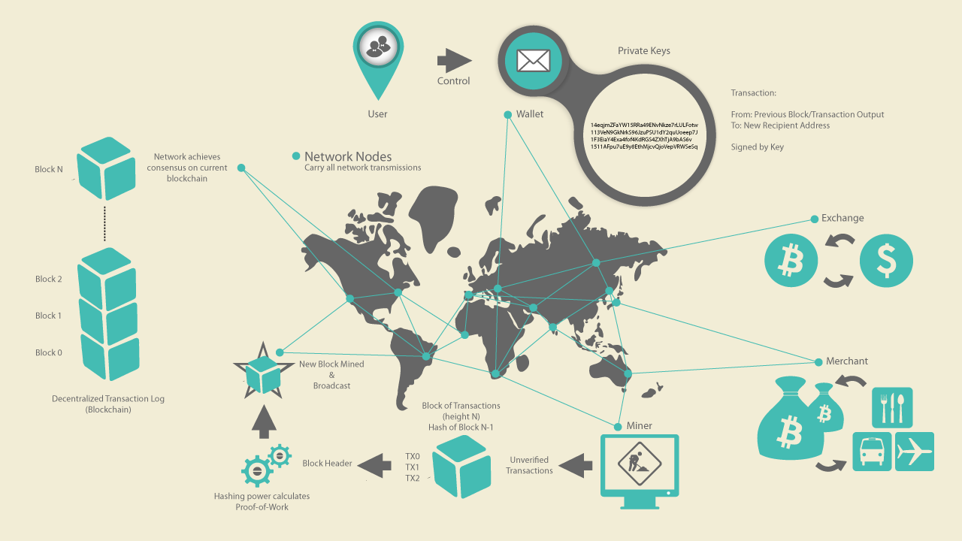

Slide 23
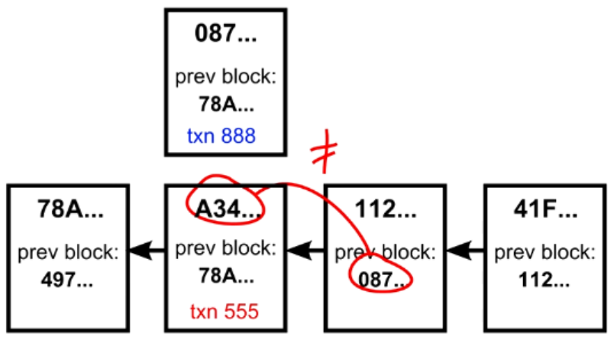
Double Spending in the Block Chain

